Slide 1
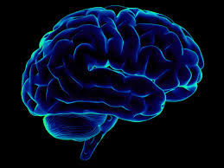

Assembly Elections-2018
Telangana , Rajasthan and Madhya Pradesh Election twitter sentiment Analysis
Team:
V .Venkata Sai Kushwanth Reddy[11810002]
Satwick Bodduna[11810077]

Slide 2
Table of Content
Business Understanding
Introduction
Motivation for this study
Questions & Hypothesis
Data collection
Data cleaning and Preparation for analysis
Data Analysis with results

Slide 3
Business Understanding
Political parties left no stone unturned in their bid to outdo each other in below states which are
Madhya Pradesh
Rajasthan
Chhattisgarh
Mizoram and
Telangana by fielding key leaders, poaching heavyweights, forging alliances etc...
Many news channels and newspapers continued predicting election results majorly by doing surveys and assessing social media reactions where Voter’s expressed their views in social media platforms like Twitter & Facebook.
Introduction:
Election season got kicked off before the general assembly elections 2019 which is referred as semifinal before hitting the road to finale of 2019 general elections.
Assembly Elections 2018 is glorified as mandate of voter’s emotions for predicting 2019 Lok Sabha elections which made its one of the most discussed topic across India all over social platforms.

Slide 4
Motivation for this study:
During this election season, there will be more posts and tweets from the voters across the country expressing their political views which will help to decode peoples pulse and to find the seat share projection among parties in respective states
Questions & Hypothesis:
Telangana, an incumbent state CM KCR (TRS) emphasis on the importance of winning a regional party(TRS) ,Can TRS secure a landslide victory and rule back Telangana again?
Rajasthan elections is always a see saw between Congress and BJP. With BJP is currently in power, Is it going to be congress party revival for 2019 elections beginning with Rajasthan or can BJP continue its wave?
Madhya Pradesh which has been fortress of BJP for the last 13 years under the leadership of Shivraj Singh Chauhan. Can congress increase its current tally of 57 and breach 116 landmark to form the government unanimously?

Slide 5
Data collection:
As twitter is described "the SMS of the Internet" with 100 million users posted 340 million tweets a day
We used various Hashtags to collect data through twitter API for respective states.
Tweets were collected by using state specific election hashtags during election period.
Ensured all columns filling up as expected while scarping Twitter data.
Tweets which are scrapped using the twitter API are stored into CSV files.
Scrapped information metadata (Tweet Text, created at, Location, verified, description, followers count, Tweet Date, id, statuses count).
Tools & Packages used for Collecting data:
Tweepy Library, Python, csv, anaconda

Slide 6





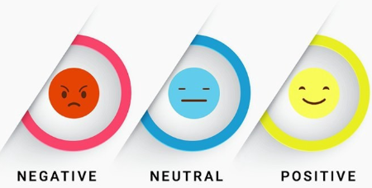
Data cleaning and Preparation for analysis :
Scrapped tweets data which was stored in csv had been loaded into the python environment(Jupyter) for cleaning the tweets as required for further analysis
Tweet Text is the Colum where we have tweet documents of users
We used custom regex expression for cleaning data and removing unwanted pattern from tweet text.
We created a logic which will assign tweets to respective political parties by inspecting from given custom dictionary of words.
Using text blob polarity, we analyzed the sentiment of each tweet and assigned sentiment scores of 1, -1 and 0

Slide 7
Where 1 is positive, -1 is negative and 0 is neutral tweet
We added a flag to the data frame for further processing and analyzing in tableau to differentiate different states data.
Then we removed stop words from cleaned tweets and have split into words for analyzing most frequent words and further added state tag to the data frame
Stored both analyzed tweets information with columns of sentiment score and party in single csv and hashtag frequency data frame into another csv for analyzing the data in tableau
Tools & Packages used for preparation and cleaning:
NLTK, Pandas, NumPy, Textblob, Matplot, Python, csv, anaconda

Slide 8
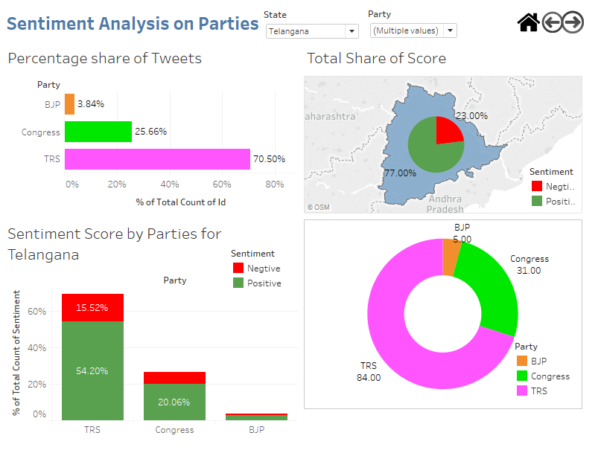
Telangana Election twitter sentiment Analysis Results
Looks like TRS is going to secure a landslide victory

Slide 9
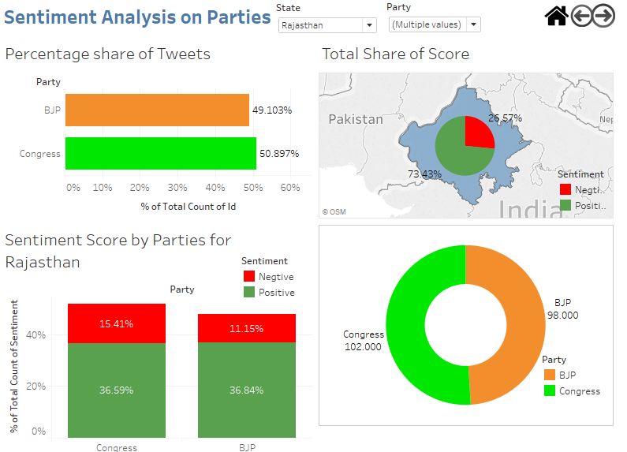
Rajasthan Election twitter sentiment Analysis Results
Rajasthan election might be going to be neck to neck contest

Slide 10
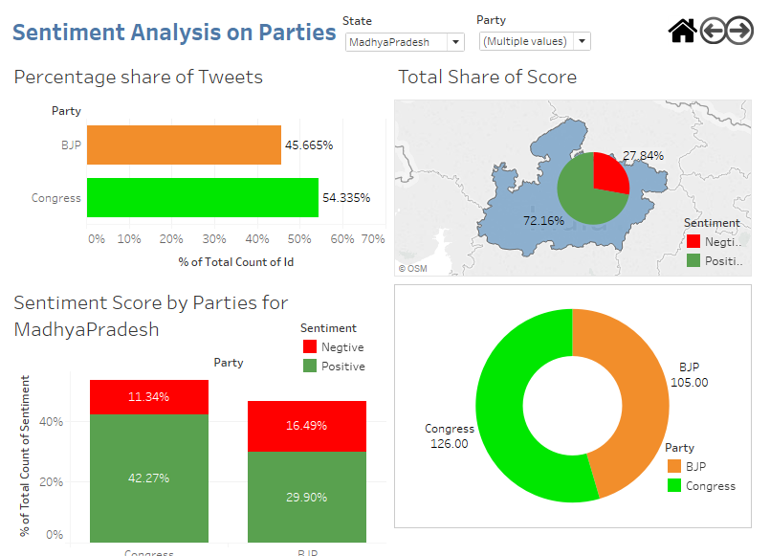
Madhya Pradesh Election twitter sentiment Analysis Results
Congress has slight upper hand than the BJP in MP

